Slide 1
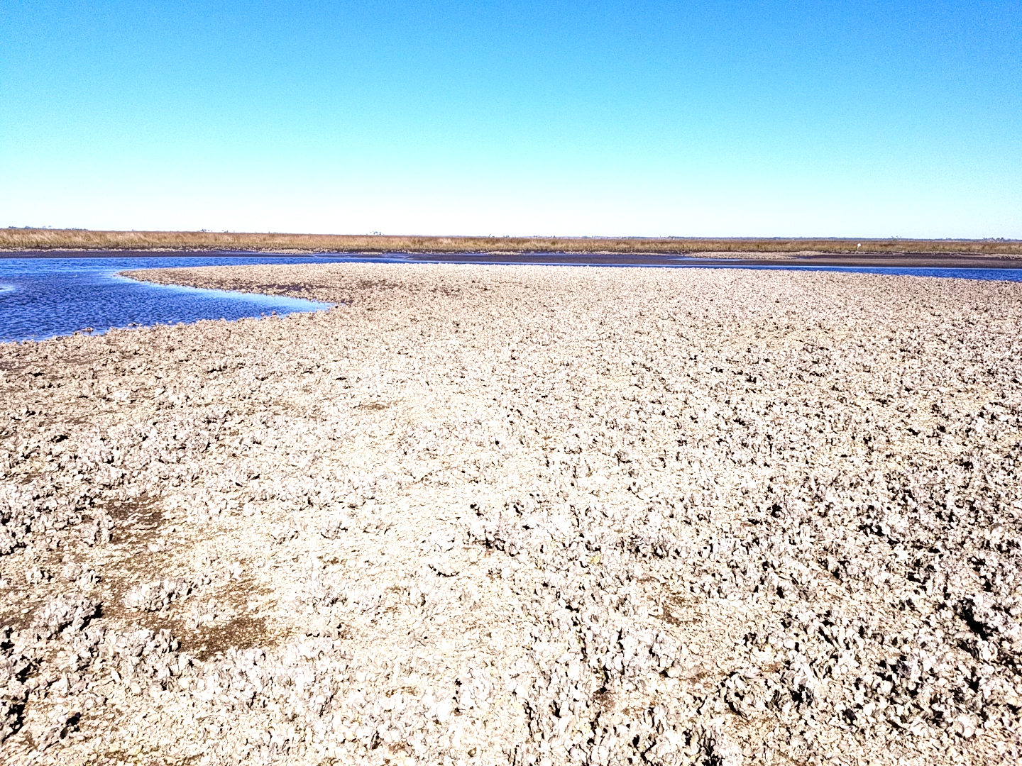




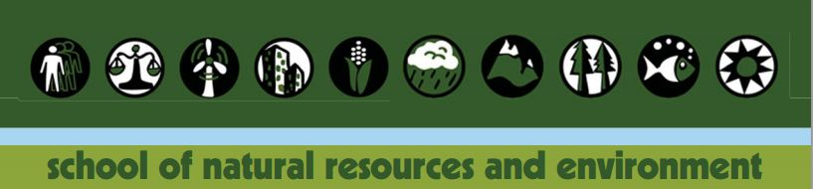
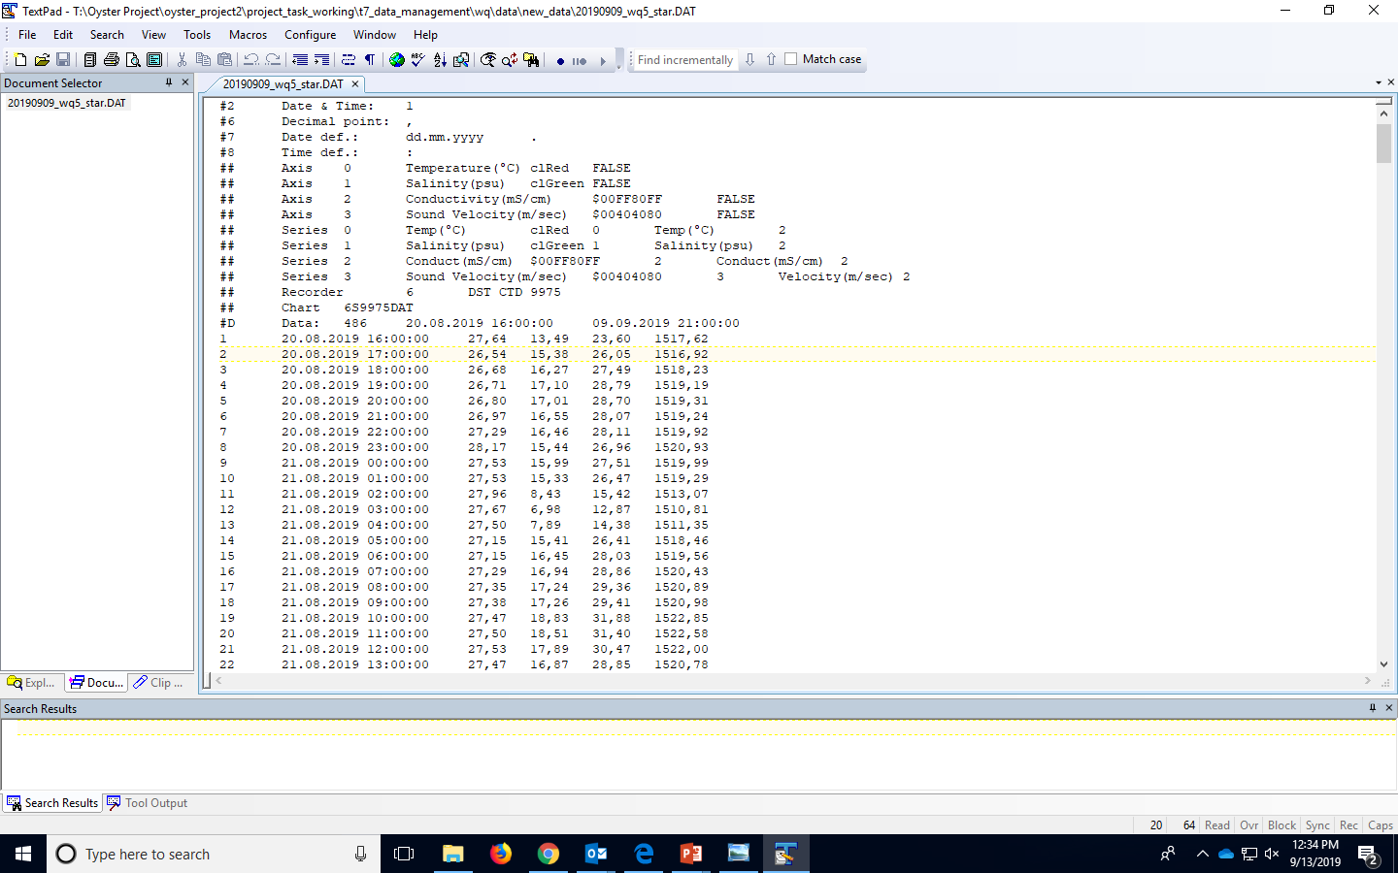
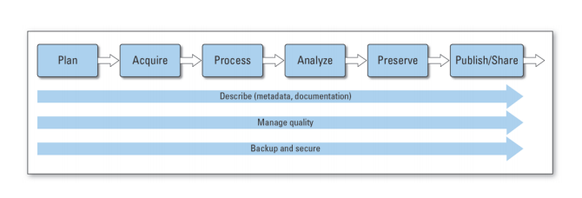
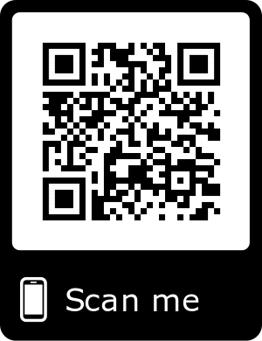
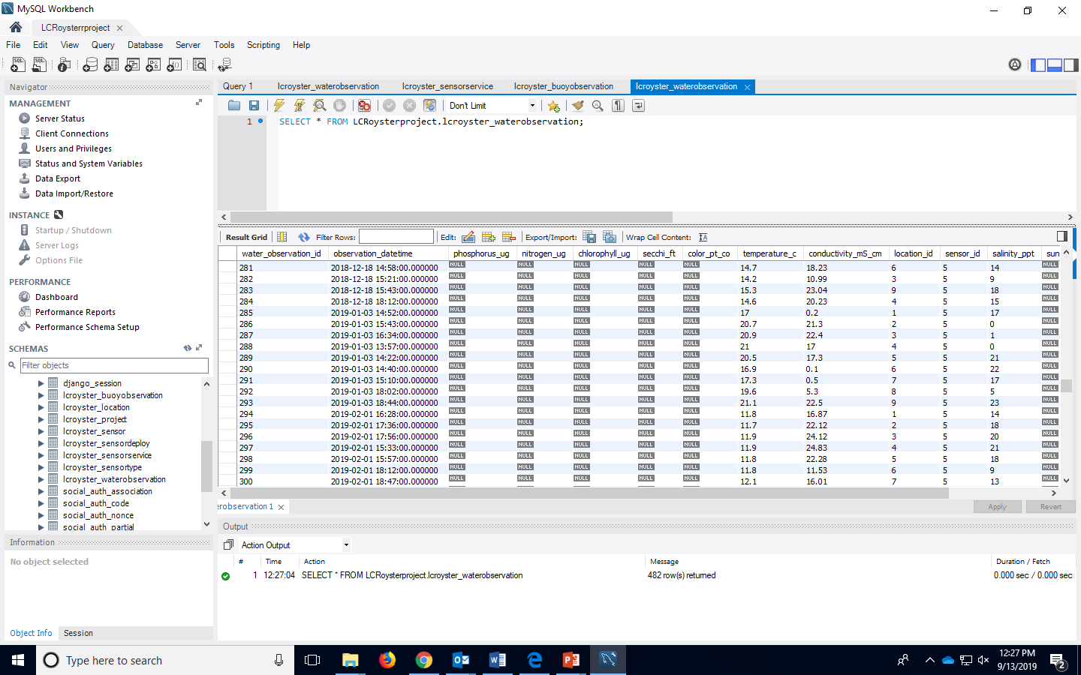
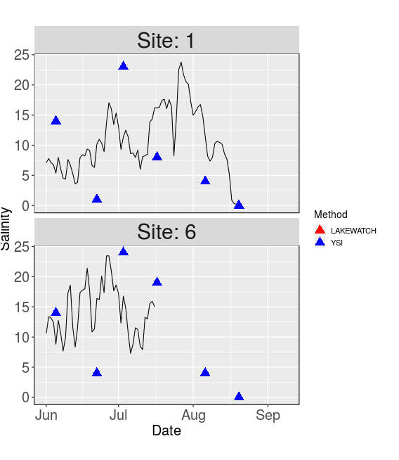
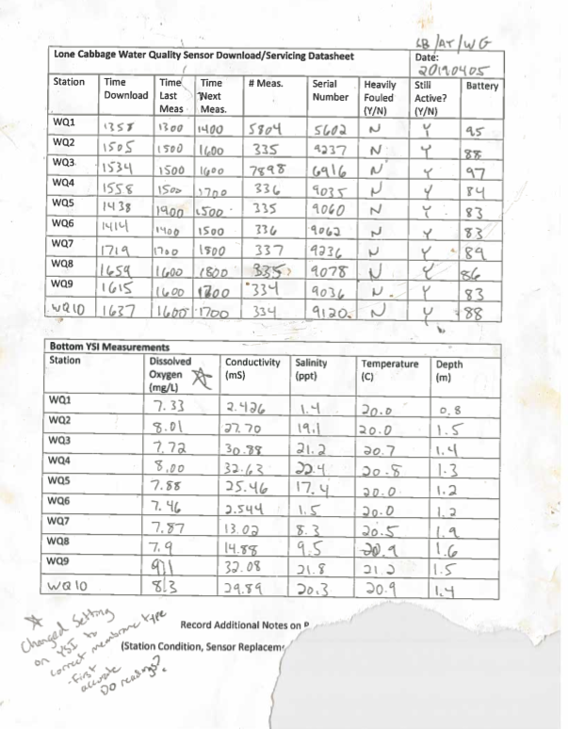
Big Changes in the Big Bend:
A Data Management Story
Introduction
Methodology
Interactive Shiny App
“Living data” are defined as data which are continuously collected and added to existing collected data. Living data are challenging with from a data management perspective because the data (by design) continuously change as new data are collected.
Creating and automating a data workflow for living data is an emerging skill for natural resource professionals. More than ever, data management is recognized as a core skill for biologists and ecologists (Hampton et al. 2017).
Figure1- USGS Data Management Guidelines
QA/QC DURING DATA ENTRY:
Paper data sheets to electronic records
The process of transferring data from paper datasheets to electronic form is a common source of potential errors. Double data entry and added QA/QC procedures help ensure data integrity.
Transfer electronic records from sensor to database
When individually collected sensor data files are transported back to the lab these files must be checked for errors and the data amended to an existing database to provide a continuous record of the water quality observations of interest. In our project this is done by:
Step 1. Automated data import using custom Python code for initial QA/QC and storing in mySQL database for storage.
Step 2. Create a series of checks to ensure data integrity, using data analysis software (i.e R, python).
Step 3. Create visualizations and summary tables, , using data analysis software (i.e R).
Future Data Work
Acknowledgments:
Dan Maxwell - Associate University Librarian at the University of Florida
Plato Smith - Data Management Librarian at the University of Florida
Robert Phillips - Information Technologist, George A. Smathers Libraries at the University of Florida
Peter Fredrick - Research Professor in the Department of Wildlife Ecology and Conservation at the University of Florida
Steve Beck - Research Coordinator for Lone Cabbage Reef Restoration Project at the University of Florida
Sarah Meyer - Health Sciences Librarian at the University of Florida

